Slide 1
Chapter Two
How are Numbers and Characters Represented?

Slide 2
How Data are Represented
Affects
Accuracy
Speed
Range of values (including alphabet)
Audio and video resolution
File size
Download and operational times

Slide 3
This Document So Far
$ unzip Chapter\ 02.pptx
Archive: Chapter 02.pptx
inflating: [Content_Types].xml
inflating: _rels/.rels
inflating: ppt/slides/_rels/slide2.xml.rels
inflating: ppt/slides/_rels/slide1.xml.rels
inflating: ppt/_rels/presentation.xml.rels
inflating: ppt/presentation.xml
inflating: ppt/slides/slide1.xml
inflating: ppt/slides/slide2.xml

Slide 4
This Document So Far
inflating: ppt/slideLayouts/_rels/slideLayout1.xml.rels
inflating: ppt/slideLayouts/_rels/slideLayout2.xml.rels
inflating: ppt/slideMasters/_rels/slideMaster1.xml.rels
inflating: ppt/slideLayouts/_rels/slideLayout5.xml.rels
inflating: ppt/slideLayouts/_rels/slideLayout4.xml.rels
inflating: ppt/slideLayouts/_rels/slideLayout6.xml.rels
inflating: ppt/slideLayouts/slideLayout5.xml
inflating: ppt/slideLayouts/_rels/slideLayout3.xml.rels

Slide 5
This Document So Far
inflating: ppt/slideMasters/slideMaster1.xml
inflating: ppt/slideLayouts/slideLayout1.xml
inflating: ppt/slideLayouts/slideLayout2.xml
inflating: ppt/slideLayouts/slideLayout3.xml
inflating: ppt/slideLayouts/slideLayout4.xml
inflating: ppt/slideLayouts/slideLayout6.xml
extracting: ppt/media/image2.jpg
extracting: ppt/media/image1.jpg

Slide 6
This Document So Far
inflating: ppt/theme/theme1.xml
extracting: docProps/thumbnail.jpeg
inflating: ppt/viewProps.xml
inflating: ppt/tableStyles.xml
inflating: ppt/presProps.xml
inflating: docProps/app.xml
inflating: docProps/core.xml
inflating: ppt/printerSettings/printerSettings1.bin

Slide 7
Slide1.xml
<?xml version="1.0" encoding="UTF-8" standalone="yes"?>
<p:sld xmlns:a="http://schemas.openxmlformats.org/drawingml/2006/main" xmlns:r="http://schemas.openxmlformats.org/officeDocument/2006/relationships" xmlns:p="http://schemas.openxmlformats.org/presentationml/2006/main"><p:cSld><p:spTree><p:nvGrpSpPr><p:cNvPr id="1" name=""/><p:cNvGrpSpPr/><p:nvPr/></p:nvGrpSpPr><p:grpSpPr><a:xfrm><a:off x="0" y="0"/><a:ext cx="0" cy="0"/><a:chOff x="0" y="0"/><a:chExt cx="0" cy="0"/></a:xfrm></p:grpSpPr><p:sp><p:nvSpPr><p:cNvPr id="4" name="Title 3"/><p:cNvSpPr><a:spLocks noGrp="1"/></p:cNvSpPr><p:nvPr><p:ph type="ctrTitle"/></p:nvPr></p:nvSpPr><p:spPr/><p:txBody><a:bodyPr/><a:lstStyle/><a:p><a:r><a:rPr lang="en-US" dirty="0" smtClean="0"/><a:t>Chapter Two</a:t></a:r><a:endParaRPr lang="en-US" dirty="0"/></a:p></p:txBody></p:sp></p:spTree><p:extLst><p:ext uri="{BB962C8B-B14F-4D97-AF65-F5344CB8AC3E}"><p14:creationId xmlns:p14="http://schemas.microsoft.com/office/powerpoint/2010/main" val="4100794241"/></p:ext></p:extLst></p:cSld><p:clrMapOvr><a:masterClrMapping/></p:clrMapOvr></p:sld>

Slide 8
Slide2.xml
<?xml version="1.0" encoding="UTF-8" standalone="yes"?>
<p:sld xmlns:a="http://schemas.openxmlformats.org/drawingml/2006/main" xmlns:r="http://schemas.openxmlformats.org/officeDocument/2006/relationships" xmlns:p="http://schemas.openxmlformats.org/presentationml/2006/main"><p:cSld><p:spTree><p:nvGrpSpPr><p:cNvPr id="1" name=""/><p:cNvGrpSpPr/><p:nvPr/></p:nvGrpSpPr><p:grpSpPr><a:xfrm><a:off x="0" y="0"/><a:ext cx="0" cy="0"/><a:chOff x="0" y="0"/><a:chExt cx="0" cy="0"/></a:xfrm></p:grpSpPr><p:sp><p:nvSpPr><p:cNvPr id="4" name="Title 3"/><p:cNvSpPr><a:spLocks noGrp="1"/></p:cNvSpPr><p:nvPr><p:ph type="title"/></p:nvPr></p:nvSpPr><p:spPr/><p:txBody><a:bodyPr/><a:lstStyle/><a:p><a:r><a:rPr lang="en-US" dirty="0" smtClean="0"/><a:t>How Data are Represented</a:t></a:r><a:endParaRPr lang="en-US" dirty="0"/></a:p></p:txBody></p:sp><p:sp><p:nvSpPr><p:cNvPr id="5" name="Content Placeholder 4"/><p:cNvSpPr><a:spLocks noGrp="1"/></p:cNvSpPr><p:nvPr><p:ph idx="1"/></p:nvPr></p:nvSpPr><p:spPr/><p:txBody><a:bodyPr/><a:lstStyle/><a:p><a:r><a:rPr lang="en-US" dirty="0" smtClean="0"/><a:t>Affects</a:t></a:r></a:p><a:p><a:pPr lvl="1"/><a:r><a:rPr lang="en-US" dirty="0" smtClean="0"/><a:t>Accuracy</a:t></a:r></a:p><a:p><a:pPr lvl="1"/><a:r><a:rPr lang="en-US" dirty="0" smtClean="0"/><a:t>Speed</a:t></a:r></a:p><a:p><a:pPr lvl="1"/><a:r><a:rPr lang="en-US" dirty="0" smtClean="0"/><a:t>Range of values (including alphabet)</a:t></a:r></a:p><a:p><a:pPr lvl="1"/><a:r><a:rPr lang="en-US" dirty="0" smtClean="0"/><a:t>File size</a:t></a:r></a:p><a:p><a:pPr lvl="2"/><a:r><a:rPr lang="en-US" dirty="0" smtClean="0"/><a:t>Download and </a:t></a:r><a:r><a:rPr lang="en-US" smtClean="0"/><a:t>operational times</a:t></a:r><a:endParaRPr lang="en-US" dirty="0" smtClean="0"/></a:p><a:p><a:pPr lvl="1"/><a:r><a:rPr lang="en-US" dirty="0" smtClean="0"/><a:t>Resolution</a:t></a:r></a:p><a:p><a:pPr lvl="1"/><a:endParaRPr lang="en-US" dirty="0"/></a:p></p:txBody></p:sp></p:spTree><p:extLst><p:ext uri="{BB962C8B-B14F-4D97-AF65-F5344CB8AC3E}"><p14:creationId xmlns:p14="http://schemas.microsoft.com/office/powerpoint/2010/main" val="2251087167"/></p:ext></p:extLst></p:cSld><p:clrMapOvr><a:masterClrMapping/></p:clrMapOvr></p:sld>

Slide 9
Speed, Accuracy, Capability, Size
Inaccurate calculations can be fast
Arbitrary precision is slow
Monetary units are tricky
Display only simple fonts and characters
Don’t need to store or download

Slide 10
Money
Actual monthly payment = 2704.65
Actual total payment = 973674.00
---------- float ----------
Float monthly payment = 2704.654
Float total payment = 973675.44
---------- double ----------
Double monthly payment = 2704.6540626894594
Double total payment = 973675.4625682053
---------- BigDecimal ----------
BigDecimal monthly payment = 2704.65
BigDecimal total payment = 973674.00
Notes:
http://www.k336.org/2009/07/java-and-financial-calculations.html

Slide 11
Numbering
For a base-N system, numbers go from 0 – N-1
Each increasing digit multiplies by increasing powers of base
Anything to the zero power == 1

Slide 12
Base 10
Number | 2 | 5 | 5
Multiplier | 100 | 10 | 1
Power of 10 | 2 | 1 | 0
Result | 200 | 50 | 5

Slide 13
Binary
Number | 1 | 1 | 1 | 1 | 1 | 1 | 1 | 1
Multiplier | 128 | 64 | 32 | 16 | 8 | 4 | 2 | 1
Power of 2 | 7 | 6 | 5 | 4 | 3 | 2 | 1 | 0
 | 128 | 64 | 32 | 16 | 8 | 4 | 2 | 1

Slide 14

Woo Hoo!

Slide 15
Octal
Number | 3 | 7 | 7
Multiplier | 64 | 8 | 1
Power of 8 | 2 | 1 | 0
 | 192 | 56 | 7

Slide 16
Hexadecimal
Number | F (15) | F (15)
Multiplier | 16 | 1
Power of 16 | 1 | 0
 | 240 | 15

Slide 17
Why Do Computers Use Binary?
Easy translation between transistors and numbers
Transistors (and gates) can have greater resistance to variance

Slide 18
Bits
Every time one bit is added, range doubled
~3 bits represent a decimal digit

Slide 19
Historic Vernacular
Bit (binary digit) (1)
Nibble (4) (0 – 15)
Byte (8) (0 – 255)
Called in networking octet
Half word (16) (0 – 65535)
Word (32) ( 0 – 4,294,967,295)
Double word (64) (0 – 18,446,744,073,709,551,615 (quintillion))

Slide 20
Negative
Often, the first bit is used to denote a negative number
For a 16-bit number, actually have 15 bits to hold number
-32,768 – 32,767
In general for N bits: -2^{N}/2 – (2^{N}/2)-1

Slide 21
Powers
2¹⁰ = 1024 (kilo)
2²⁰ = 1,048,576 (mega)
2³⁰ = 1,073,741,824 (giga)
2⁴⁰ = 1,099,511,627,776 (tera)
2⁵⁰ = 1,125,899,906,842,624 (peta)

Slide 22
Analog
A continuous set of values
LP vs. CD
CD uses Digital to Analog Converter (DAC)
Conversion can’t be exact

Slide 23
Radios
Typically amplitude modulation or frequency modulation
Carrier signal at specific frequency
Signal varies in amplitude (strength)
Signal varies in frequency
Can also vary phase

Slide 24
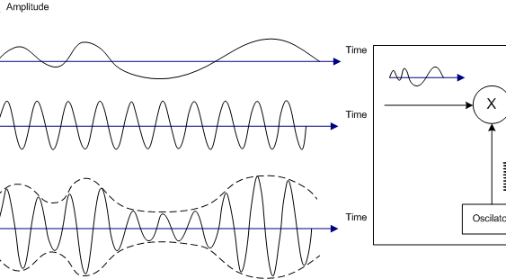
AM Transmission
Notes:
https://en.wikipedia.org/wiki/File:Illustration_of_Amplitude_Modulation.png

Slide 25
AM Transmission
In the US, susceptible to interference such as lighting, appliances, etc.
540–1610 kHz with 10 kHz spacing
Difficult to detect transmission troubles
Notes:
https://en.wikipedia.org/wiki/AM_broadcasting

Slide 26
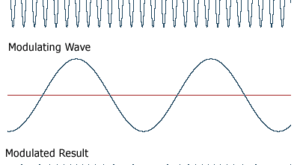
FM Transmission
Notes:
http://www.yourdictionary.com/frequency-modulation

Slide 27
FM Transmission
In the US, higher frequency (band)
More information is sent
87.5 to 108.0 MHz
Also historically for TV
Notes:
https://en.wikipedia.org/wiki/FM_broadcasting

Slide 28
Digital Transmission
HDTV
Didn’t change the frequencies
VHF Band - Ch. 2 – 13: 54 – 216 MHz
High Band - VHF Ch. 7 – 13: 175 – 216 MHz
Mid Band - UHF Ch. 14 – 22: 121 – 174 MHz
Added resolution via compression
Notes:
http://www.csgnetwork.com/tvfreqtable.html

Slide 29
Analog to Digital Converter
How often, how accurate
Phone: 8000 times a second, 8 bits
CD: 44,100 times a second, 16 bits
Recordable on PAL and NSTC video recorders
Digital sources can add error detection and correction codes

Slide 30
Representing Numbers
Fixed size: always use the same number of bits
Fast: bus and ALU width
Might lose precision
Variable size: use the number of bits necessary to represent the number
Slow: multiple transfers and calculations needed
Better precision, though repeating numbers not exactly representable
Need rational number class for that

Slide 31
Examples of Bad Number Storage
Y2K
Programmers in the 60’s didn’t think their programs would still be running in 2000
Used two places to represent year
787
A 32-bit variable can overflow every 248 days and result in “loss of control”

Slide 32
Storing Real Numbers
Keep track of numbers before the decimal point and numbers after
Fixed point
Bits after represent negative powers of two
Always have same precision
Floating point numbers allow where the decimal point is to move
Allows for more flexibility in representation

Slide 33
Typical Floating-Point Numbers
32 bits
1 sign bit
23 for the digits (mantissa)
8 for the exponent
64 bits
1 sign bit
32 bits for the digits
11 for the exponent

Slide 34
Rounding
When a a number has more decimal places than the amount storage, rounding occurs
When the number becomes too large or too small, overflow or underflow occurs

Slide 35
IEEE-754 Standard
+ and - infinities
Not A Number
Rounding
Nearest, ties to even
Nearest, ties away from zero
Toward 0
Toward either + or - infinity
Notes:
https://en.wikipedia.org/wiki/IEEE_floating_point

Slide 36
Round-Off Errors
public class Rounding
{
public static void main (String args[])
{
double a = 0.7; System.out.println (a);
double b = 0.9; System.out.println (b);
double x = a + 0.1; System.out.println (x);
double y = b - 0.1; System.out.println (y);
System.out.println (x == y);
}
}

Slide 37
Round-Off Errors
$ java Rounding
0.7
0.9
0.7999999999999999
0.8
false

Slide 38
NAN and Infinites
public class NAN
{
public static void main (String args[])
{
System.out.println (0.0 / 0.0);
System.out.println (-1.0 / 0.0);
System.out.println (1.0 / 0.0);
}
}

Slide 39
NAN and Infinites
$ java NAN
NaN
-Infinity
Infinity

Slide 40
Rational Numbers
Some languages allow for numbers to be represented as fractions
Can become difficult as denominator increases

Slide 41
irb(main):004:0> Rational(7,10)
=> (7/10)
irb(main):005:0> a=Rational(7,10)
=> (7/10)
irb(main):006:0> b=Rational(9,10)
=> (9/10)
irb(main):007:0> x=a+Rational(1,10)
=> (4/5)
irb(main):008:0> y=b-Rational(1,10)
=> (4/5)
irb(main):009:0> x == y
=> true

Slide 42
Character Representation
CDC 6600: 60-bit words, 6-bit characters
IBM: Extended Binary Coded Decimal Interchange Code (EBCDIC)
American Standard Code for Information Interchange (ASCII)
26 upper and lower, Latin
Digits, uppers, lowers

Slide 43
Character Representation
ISO 8859
Different encodings for different alphabets
UTF-8
Variable length
ASCII a subset
Used in most web pages, email, etc.
E.g.: "€" is U+20AC
Notes:
https://en.wikipedia.org/wiki/UTF-8

Slide 44
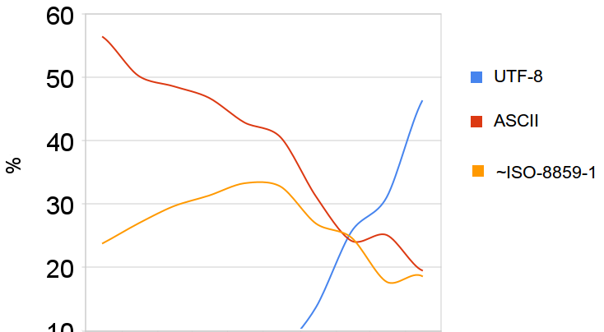

Slide 45
Unicode
UTF-16: variable 16 or 32 bits
129 modern and historic scripts
Notes:
https://en.wikipedia.org/wiki/Unicode

Slide 46
Coordination
Data and application need to agree
Web browsers
Can install character sets
Can request certain sets
Web server
May have different translations for web pages

Slide 47
Review
Questions: 1, 3, 5, 7, 9 a b, 11 a b
Exercises: 1, 3, 6
Research: 1, 3

